Slide 1
EVENT MANAGEMENT BOOKING WEBSITE
JITTU JOSE
MES20MCA-2022
PRODUCT OWNER : MR SYED FEROZE AHAMED M

Slide 2
TABLE OF CONTENTS
CONTENT | PAGE
Description About Project | 3
Modules | 4
Developing Environment | 8
Product Backlog | 9
User Story | 10
Project Plan | 11
Sprint plans | 13
Sprint 1

Slide 3
PROJECT DESCRIPTION
This Project aims to build a user friendly website for event management.
This website allows the users to select custom tailored event.
The user will be provided with all the required information for selecting an event, these features include:
Stage decorations
Cuisine
Anchor
Cultural events

Slide 4
MODULES
Module 1:-Admin
Add the collection of stages, food menu, cultural programs, anchors, vehicles with essential details.
View bookings
Module 2:-Customer
New user registration
Login
View list of decorated stages, food menu, cultural programs, anchors and vehicles with essential details
Book the event with needed items
Over view of booking.

Slide 5
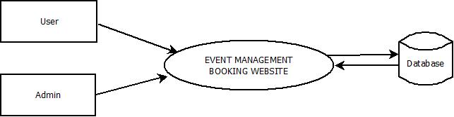
DFD: Level-0

Slide 6
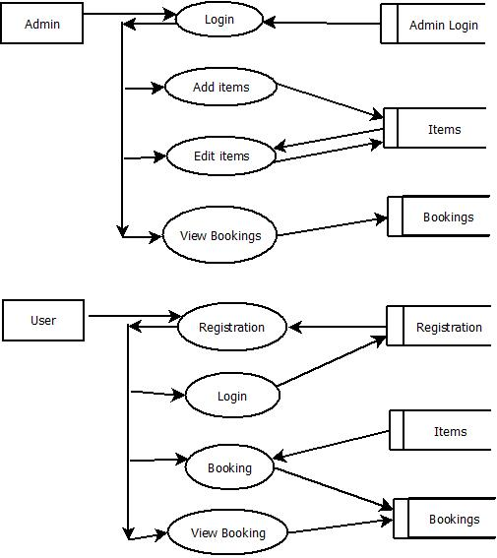
DFD: Level-1.1

Slide 7
DFD: Level-1.2

Slide 8
DEVELOPING ENVIRONMENT
Language: HTML, CSS, NodeJS, JavaScript
Front End: HTML(hbs)
Back end: nosql
Database: MongoDB
IDE: Visual Studio Code
OS: Windows/Linux

Slide 9
PRODUCT BACKLOG
User story ID | Priority <High/Medium/Low> | Size (Hours) | Sprint <#> | Status <Planned/In progress/Completed> | Release Date | Release Goal
1 | Medium |  | 1 | Completed |  | User registration form
2 | Medium |  |  | Completed |  | User Login form
3 | Medium |  | 2 | planned |  | Home page
4 | Medium |  |  | Planned |  | Admin Login
5 | Medium |  |  | planned |  | Admin View
6 | Medium |  |  | Planned |  | User View for booking
7 | High |  | 3 | Planned |  | Database operations in Admin
8 | High |  | 4 | Planned |  | Database operations for user booking
9 | Medium |  |  | Planned |  | Show booking over view
10 | Medium |  |  | Planned |  | Testing
11 | Medium |  |  | Planned |  | Website hosting

Slide 10
USER STORY
User Story ID | As a type of User | I want to <perform some task> | So that I can < Achieve Some Goal>
1 | User | Register | Login
2 | User | Login | View the selections for the events
3 | User | Select the date and place | Arrange event
4 | User | Select the items | Arrange event
5 | User | View the overview of booking | Evaluate the cost and arrangements
 | Admin | Add event items with essential details | Select suitable items
7 | Admin | View bookings | Arrange event by Event Management team

Slide 11
PROJECT PLAN
User Story ID | Task Name | Start Date | End Date | Days | Status
1 | Sprint 1 | 26/12/2021 | 28/12/2021 | 2 | Completed
2 |  | 29/12/2021 | 31/12/2021 | 3 | Completed
3 |  | 03/12/2021 | 08/01/2022 | 5 | Completed
4 | Sprint 2 | 09/01/2022 | 16/01/2022 | 8 | Planned
5 |  | 18/01/2022 | 22/01/2022 | 5 | Planned
6 | Sprint 3 | 23/01/2022 | 27/01/2022 | 5 | Planned
7 |  | 30/01/2022 | 05/02/2022 | 7 | Planned
8 | Sprint 4 | 06/02/2022 | 10/01/2022 | 5 | Planned
9 |  | 16/02/2022 | 19/02/2022 | 4 | Planned

Slide 12
SPRINT BACKLOG PLAN
Backlog Item | Status & completion date | Original estimate in hours | Day1 | Day2 | Day3 | Day4 | Day5 | Day6 | Day7 | Day8 | Day9 | Day10 | Day11 | Day12 | Day13 | Day14
User story #1,#2,#3,#4 |  | hrs | hrs | hrs | hrs | hrs | hrs | hrs | hrs | hrs | hrs | hrs | hrs | hrs | hrs | hrs
User registration form | 28/12/2021 | 2 | 1 | 1 | 0 | 0 | 0 | 0 | 0 | 0 | 0 | 0 | 0 | 0 | 0 | 0
User Login form | 31/12/2021 | 3 | 0 | 0 | 0 | 1 | 1 | 1 | 0 | 0 | 0 | 0 | 0 | 0 | 0 | 0
Home page | 08/01/2021 | 5 | 0 | 0 | 0 | 0 | 0 | 0 | 0 | 0 | 0 | 1 | 1 | 1 | 1 | 1
Admin Login
Admin View | 16/01/2022 | 5 | 1 | 1 | 0 | 1 | 0 | 1 | 0 | 1 | 0 | 0 | 0 | 0 | 0 | 0
User View for booking | 22/01/2022 | 5 | 0 | 0 | 0 | 0 | 0 | 0 | 0 | 0 | 0 | 1 | 1 | 1 | 1 | 1
Database operations in Admin | 27/01/2022 | 5 | 1 | 1 | 1 | 1 | 1 | 0 | 0 | 0 | 0 | 0 | 0 | 0 | 0 | 0
Database operations for user booking | 05/02/2022 | 5 | 0 | 0 | 0 | 0 | 0 | 0 | 0 | 1 | 0 | 1 | 1 | 1 | 0 | 1
Show booking over view | 10/01/2022 | 5 | 1 | 1 | 1 | 1 | 1 | 0 | 0 | 0 | 0 | 0 | 0 | 0 | 0 | 0
Testing
Website hosting | 20/02/2022 | 5 | 0 | 0 | 0 | 0 | 0 | 0 | 0 | 0 | 0 | 2 | 1 | 1 | 1 | 1
Total |  | 40 | 4 | 4 | 2 | 4 | 3 | 2 | 0 | 2 | 0 | 5 | 4 | 4 | 3 | 4

Slide 13
SPRINT ACTUAL
Backlog Item | Status & completion date | Original estimate in hours | Day1 | Day2 | Day3 | Day4 | Day5 | Day6 | Day7 | Day8 | Day9 | Day10 | Day11 | Day12 | Day13 | Day14
User story #1,#2,#3,#4 |  | hrs | hrs | hrs | hrs | hrs | hrs | hrs | hrs | hrs | hrs | hrs | hrs | hrs | hrs | hrs
User registration form | 28/12/2021 | 3 | 1 | 1 | 0 | 0 | 0 | 0 | 0 | 0 | 0 | 0 | 0 | 0 | 0 | 0
User Login form | 31/12/2021 | 2 | 0 | 0 | 0 | 1 | 1 | 1 | 0 | 0 | 0 | 0 | 0 | 0 | 0 | 0
Home page | 08/01/2021 | 5 | 0 | 0 | 0 | 0 | 0 | 0 | 0 | 0 | 0 | 1 | 1 | 1 | 1 | 1
Admin Login
Admin View
User View for booking
Database operations in Admin
Database operations for user booking
Show booking over view
Testing
Website hosting
Total |  | 10 | 1 | 1 | 0 | 1 | 1 | 1 | 0 | 0 | 0 | 1 | 1 | 1 | 1 | 1

Slide 14
THANK YOU

